Slide 1




REL301M CAPSTONE PROJECT
Author: NguyenNHSE185109
Supervisor: KhuongNA2

Slide 2

PROJECT BACKGROUND
Reliable medical information is hard to access in many areas, and online self-diagnosis can cause misinformation.
Standard LLMs lack structured reasoning and may give unsafe advice, so improved AI assistants are needed for safe, relevant guidance.

Slide 3

PROJECT GOALS
Fine-tune the model with Direct Preference Optimization (DPO) to align with ReAct and improve reasoning quality for Vietnamese users.
Build a Vietnamese medical agent using ReAct and MedGemma 4B, leveraging retrieval tools.

Slide 4

TIMELINE
Week 1
Study the ReAct architecture and main components
Learn to integrate external APIs
Week 2
Select an environment or simple tasks
Build a basic ReAct agent to reason and take action
Week 3
RL post-prompt training to boost performance
Evaluate planning and act abilities, write report

Slide 5
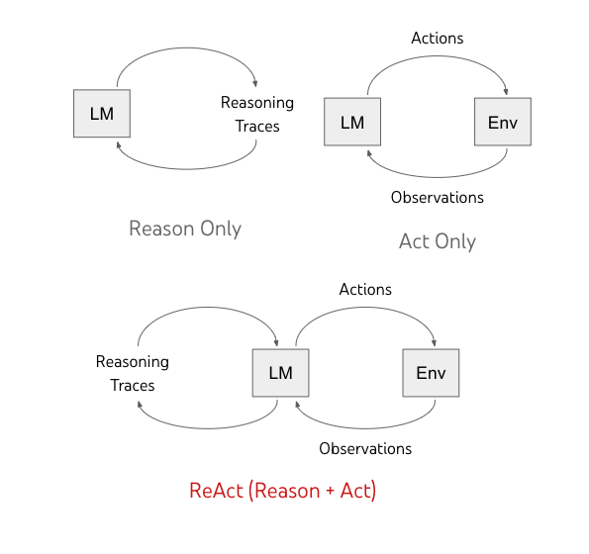
METHODOLOGY
The ReAct architecture (Reason + Act) interleaves 3 key steps to synergizes reasoning and acting:
Thought: The agent thinks and plans its next move
Action: It carries out an action, like searching or asking a question
Observation: It reviews the result, updating its understanding before starting the cycle again

Slide 6
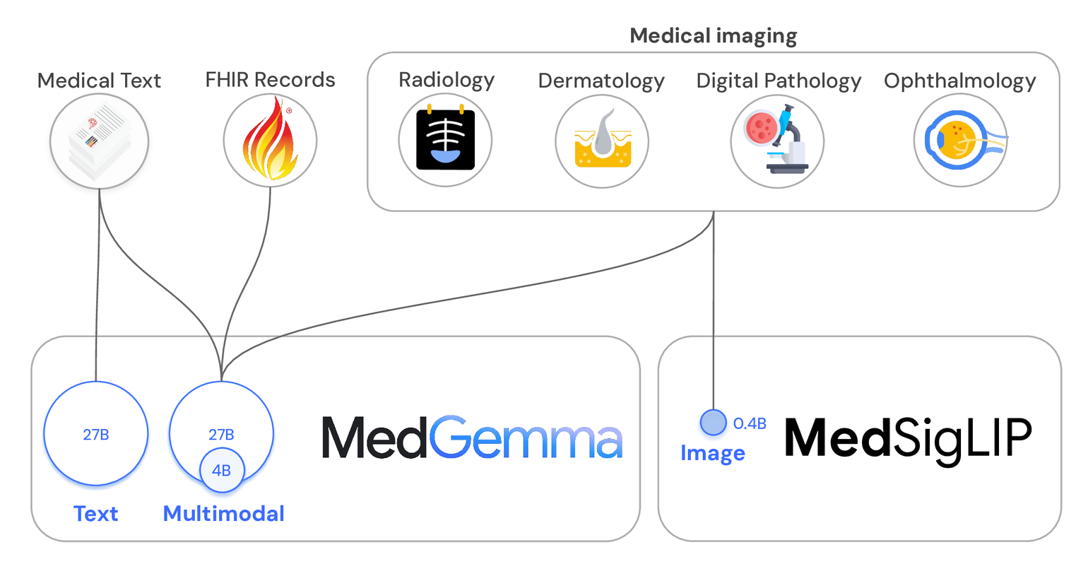
MODEL - MEDGEMMA 4B
MEDGEMMA: ADVANCED AI MODELS FOR MEDICAL TEXT AND IMAGE ANALYSIS

Slide 7
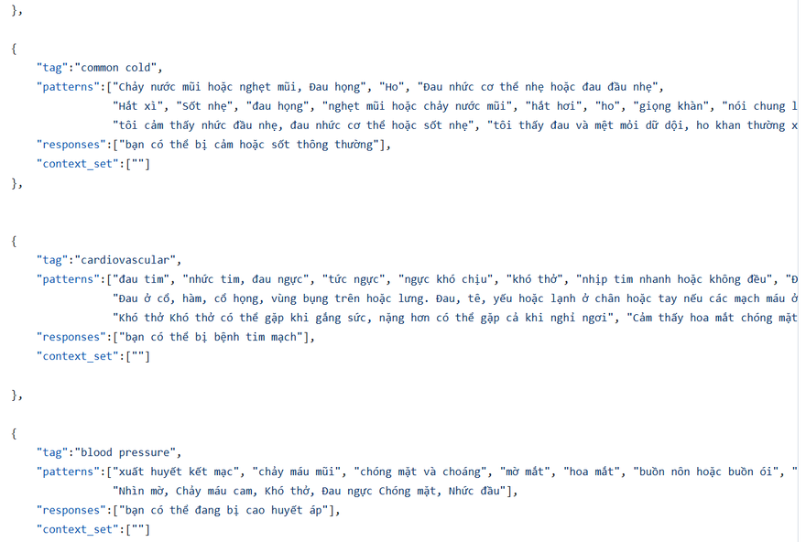
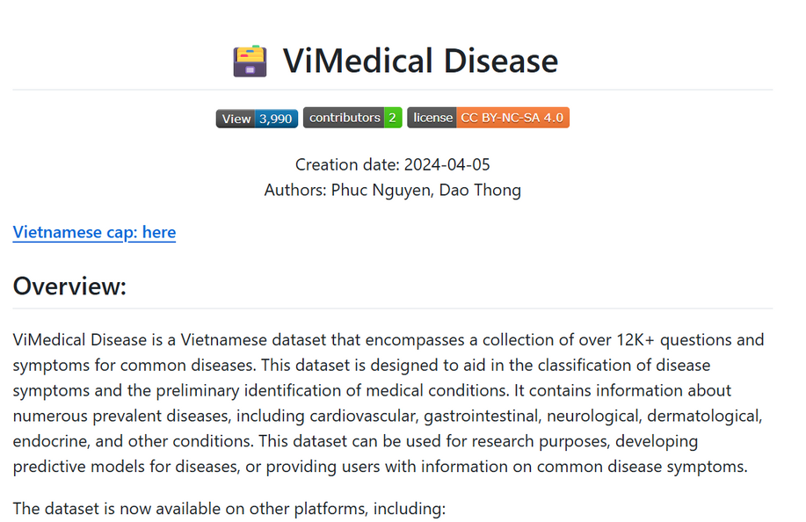
DATA - KNOWLEDGE BASE
XuanHien304/Vietnamese-medical-chatbot-based/data/intent_train.json
PB3002/ViMedical_Disease

Slide 8
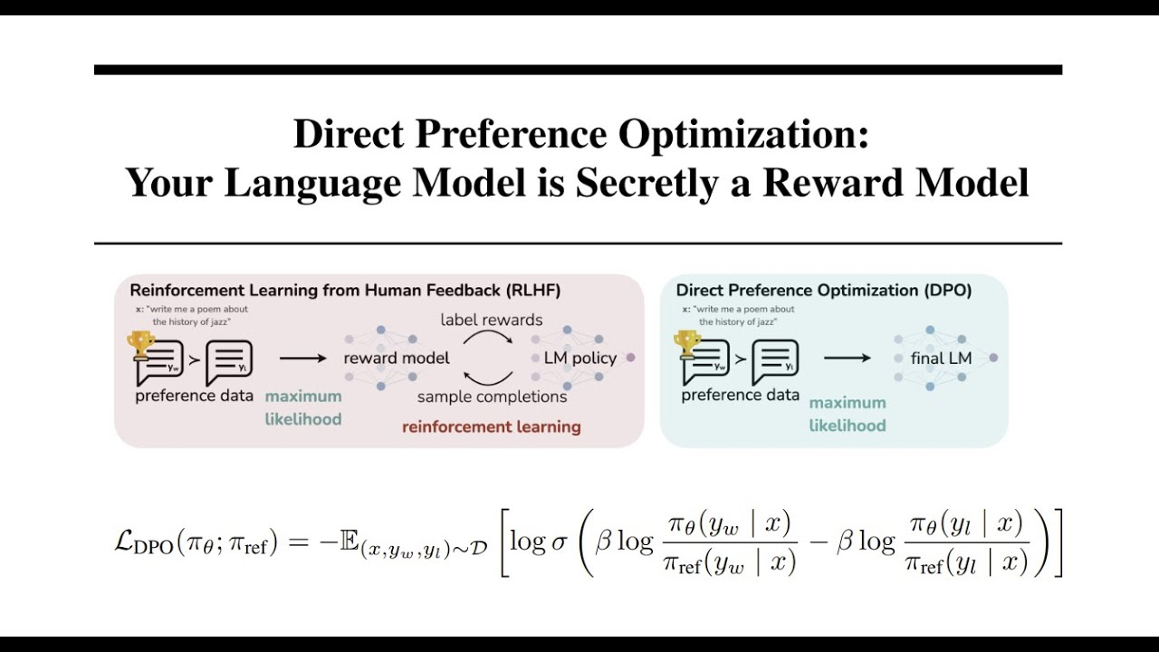
DIRECT PREFERENCE OPTIMIZATION (DPO)
DIRECT PREFERENCE OPTIMIZATION: YOUR LANGUAGE MODEL IS SECRETLY A REWARD MODEL

Slide 9
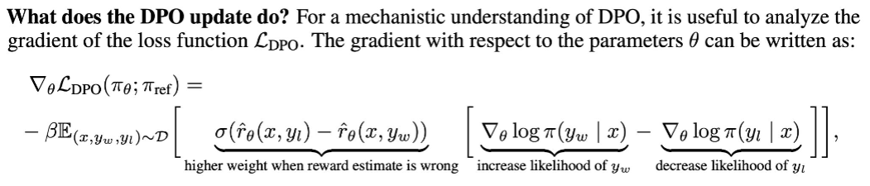
DIRECT PREFERENCE OPTIMIZATION (DPO)
Here, σ denotes the sigmoid function. The first subtraction term imposes a greater penalty when the model assigns higher reward to rejected samples, while the second term increases the likelihood of chosen over rejected responses, promoting model alignment toward more preferred data.

Slide 10
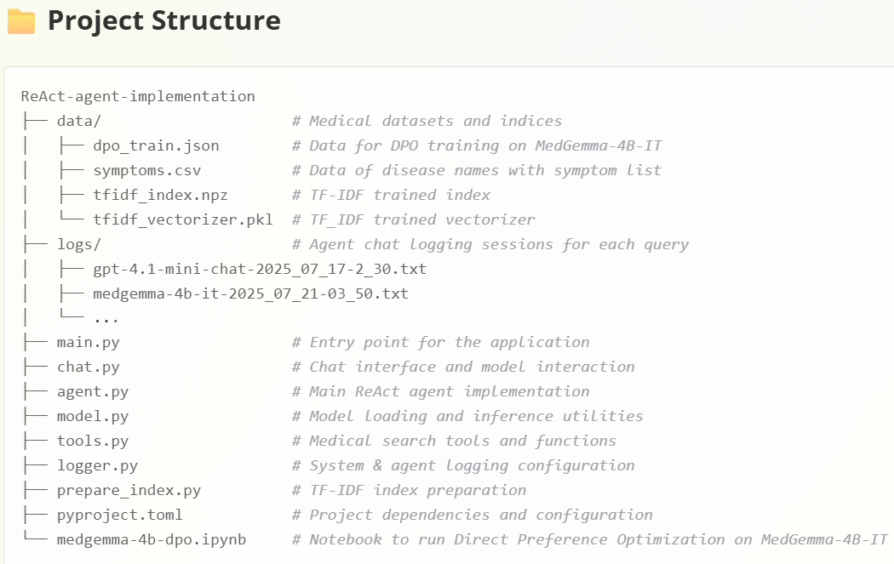
IMPLEMENTATION - PROJECT STUCTURE
Referenced and continued developing from mattambrogi/agent-implementation

Slide 11

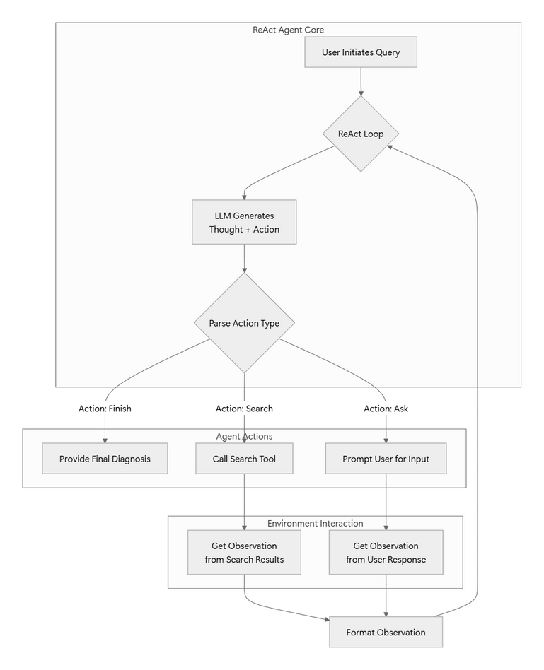
IMPLEMENTATION - SYSTEM ARCHITECTURE
ReAct medical agent workflow:
User submits query, agent enters reasoning-action loop.
Agent generates Thought and Action on each turn
Actions: are parsed into Ask (clarify), Search (external info), or Finish (diagnosis).
Observations from user or search feedback updated.
Loop repeats until diagnosis is provided and agent finish current query.

Slide 12
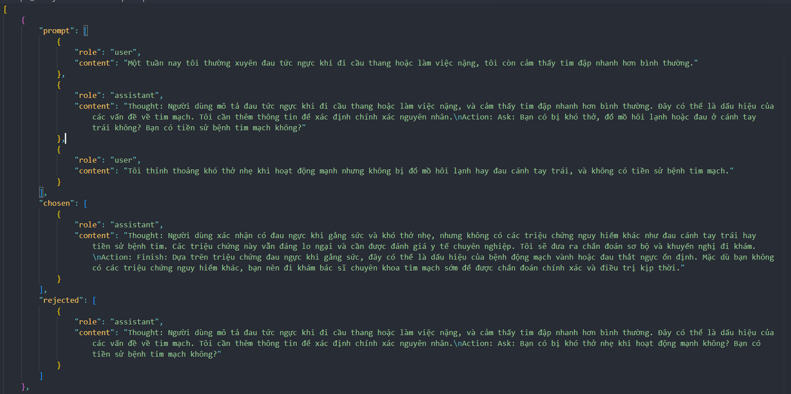
IMPLEMENTATION - DPO DATASET
Generated 10 preference samples of prompt messages, chosen output and rejected output using Gemini 2.5 Pro from agent chat logs

Slide 13
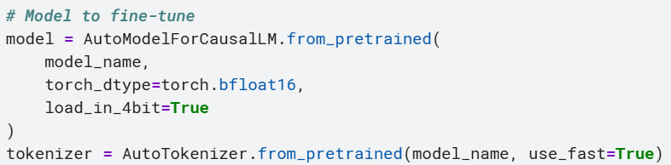
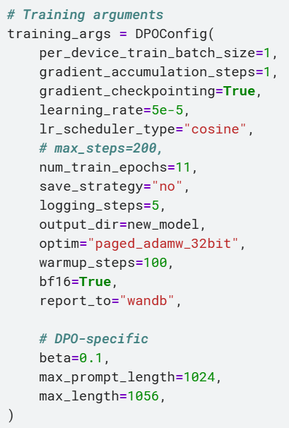
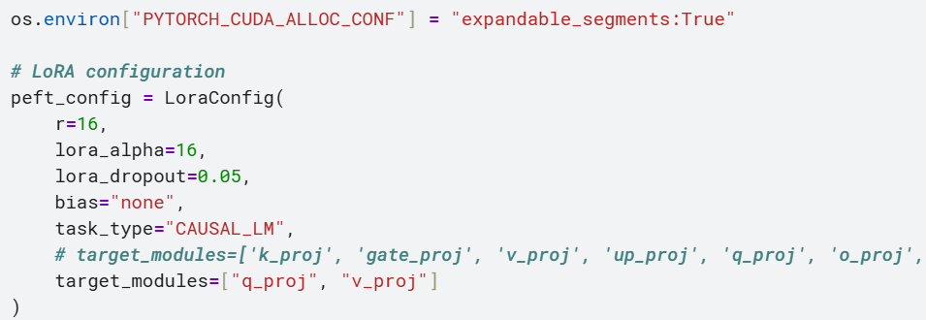
IMPLEMENTATION - DPO TRAINING
Since resources are scarce, apply QLoRA before preference tuning the model (on Kaggle NVIDIA Tesla P100, 16GB VRAM)

Slide 14
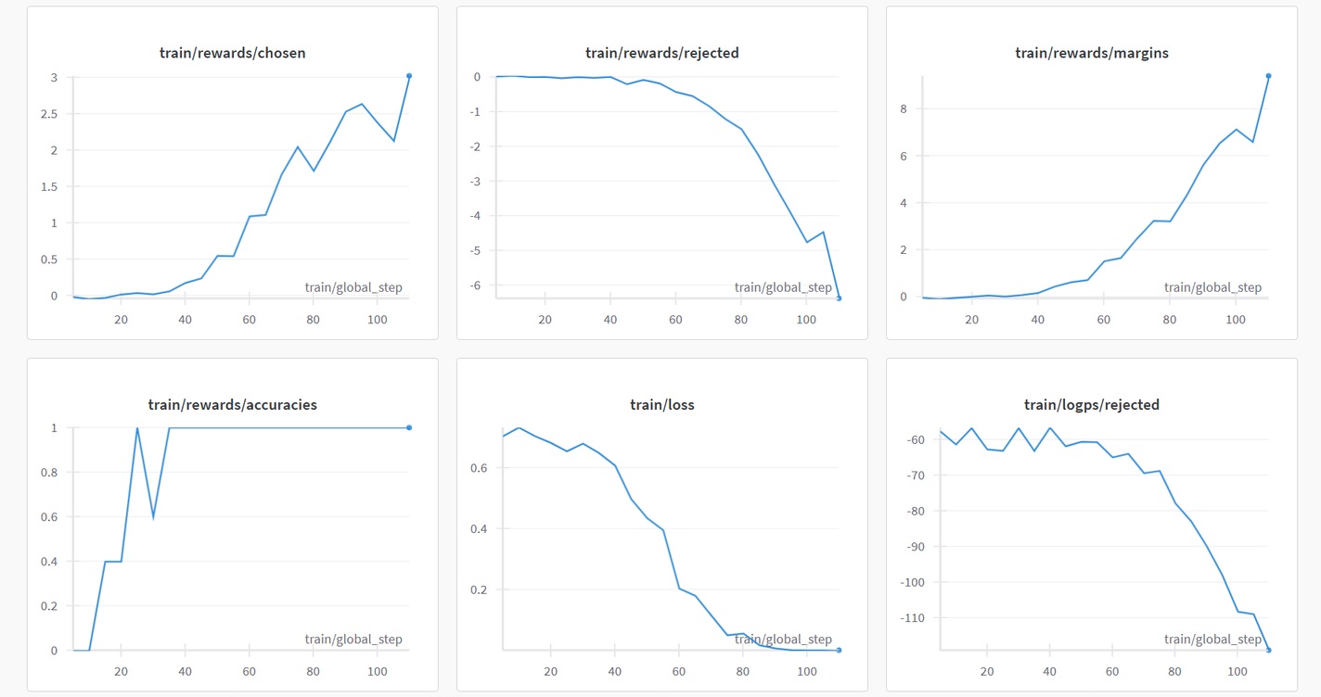
RESULT - DPO TRAINING
The reward for chosen responses increases as the reward for rejected responses declines, as expected. Reward accuracy remains at 1 after a certain point

Slide 15
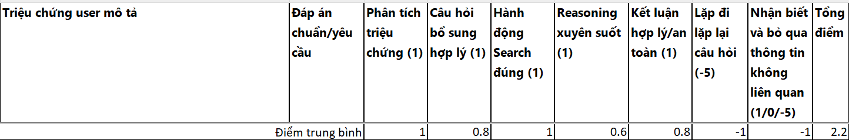
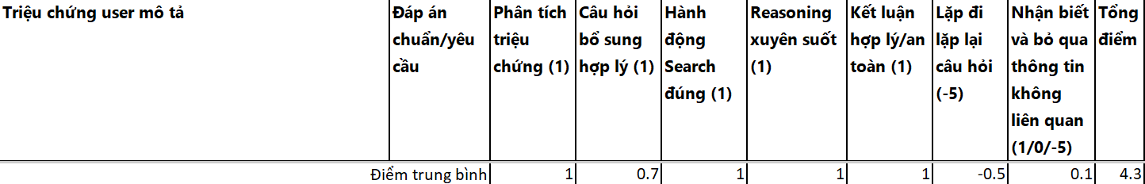
RESULT - TEST MODELS
Original model
Model after DPO

Slide 16
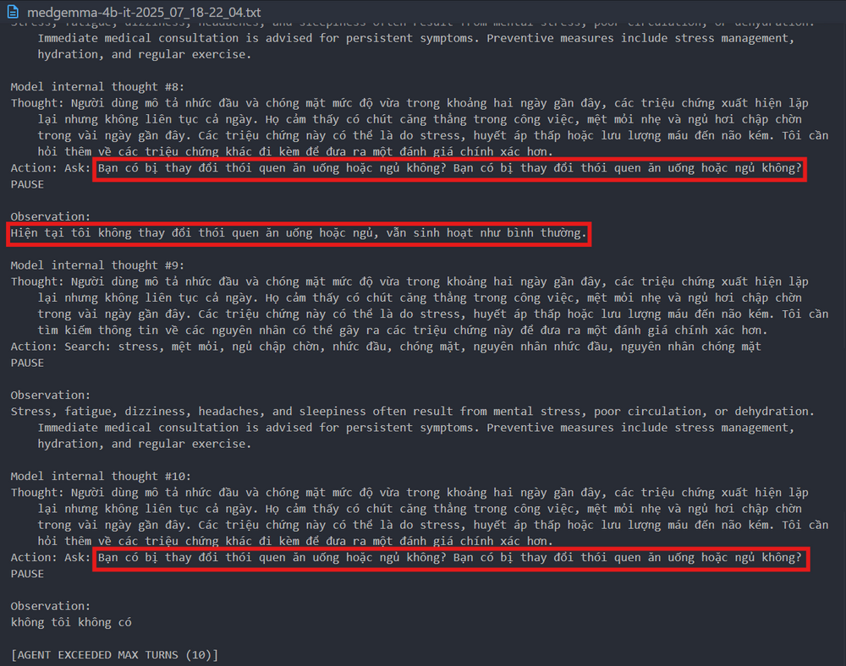
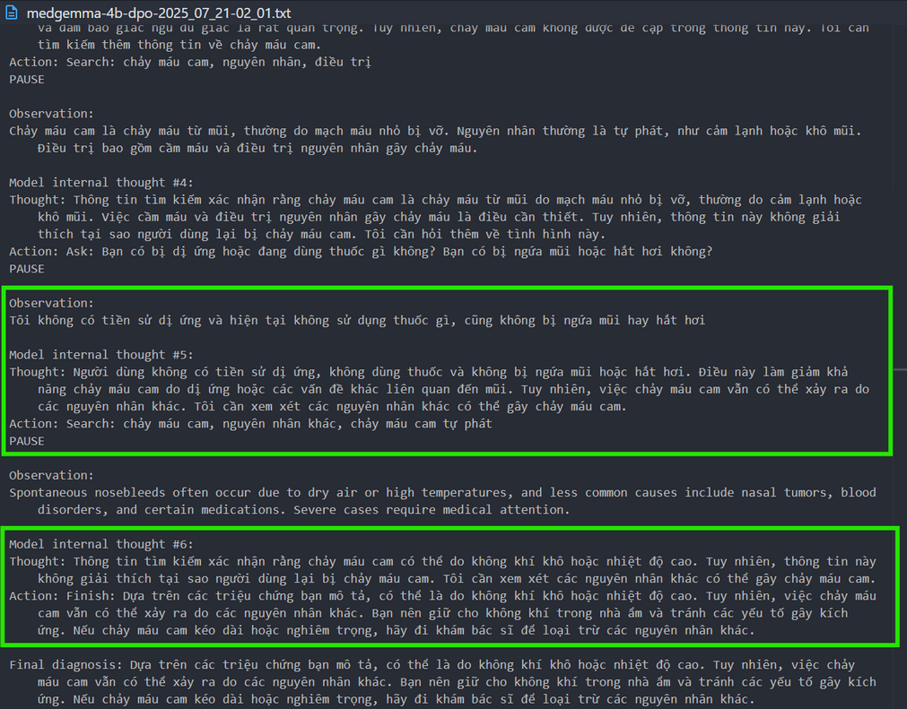
RESULT - TEST MODELS
Original model
Model after DPO

Slide 17
CONCLUSION
DPO showed significant improvement even with just 10 samples, raising the total average score from 2.2 to 4.3
The greatest improvement is in recognizing and disregarding irrelevant information.
However, it still occasionally forgets user-provided symptoms across turns, resulting in repeated questions.
All other evaluation criteria also improved notably after applying DPO, with individual max score went up to 6.
The agent took 2~3 mins on each turn to generate next response on local laptop (Windows 11, NVIDIA Quadro RTX 5000 16GB VRAM)

Slide 18




IMPROVEMENT SUGGESTION
Update the system prompt to maintain context across chats and prevent repeating or forgetting information.
Add a tool to log symptoms into a persistent memory record.
Enhance the search tool to handle multiple queries or synthesize data from various sources.

Slide 19
REFERENCES
ReAct: Synergizing Reasoning and Acting in Language Models
MedGemma: Advanced AI Models for Medical Text and Image Analysis
[GitHub] mattambrogi/agent-implementation: Basic ReAct agent implementation in Python from scratch
[GitHub] XuanHien304/Vietnamese-medical-chatbot-based: A simple Vietnamese Medical Chatbot Based
[GitHub] PB3002/ViMedical_Disease: A Vietnamese dataset of over 12 thousands questions about common disease symptoms.
[arXiv] QLoRA: Efficient Finetuning of Quantized LLMs
[arXiv] Direct Preference Optimization: Your Language Model is Secretly a Reward Model

Slide 20
THANK YOU

